Slide 1
Pascal Programming Language
Presentation made by Rudenko A. and Mayorov F.

Slide 2
Introduction
Welcome to our Pascal programming presentation.
Pascal is a programming language named after Blaise Pascal, a mathematician.
It was created by Niklaus Wirth in the late 1960s and early 1970s to make programming easier to learn.

Slide 3
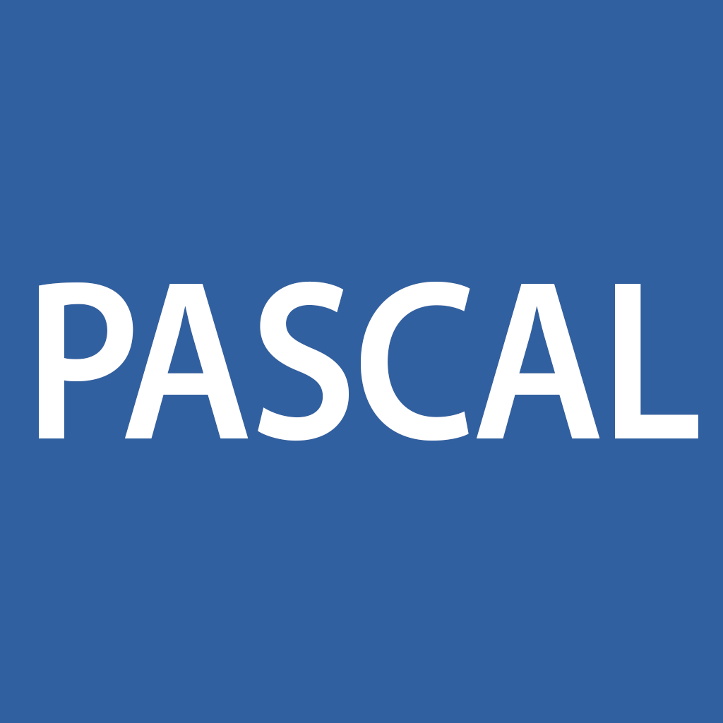
Key Features
Pascal is simple and easy to understand, making it great for learning.
It makes sure data types are used correctly, making programs safer.
Pascal supports organized programming, which helps keep code neat and easy to manage.

Slide 4
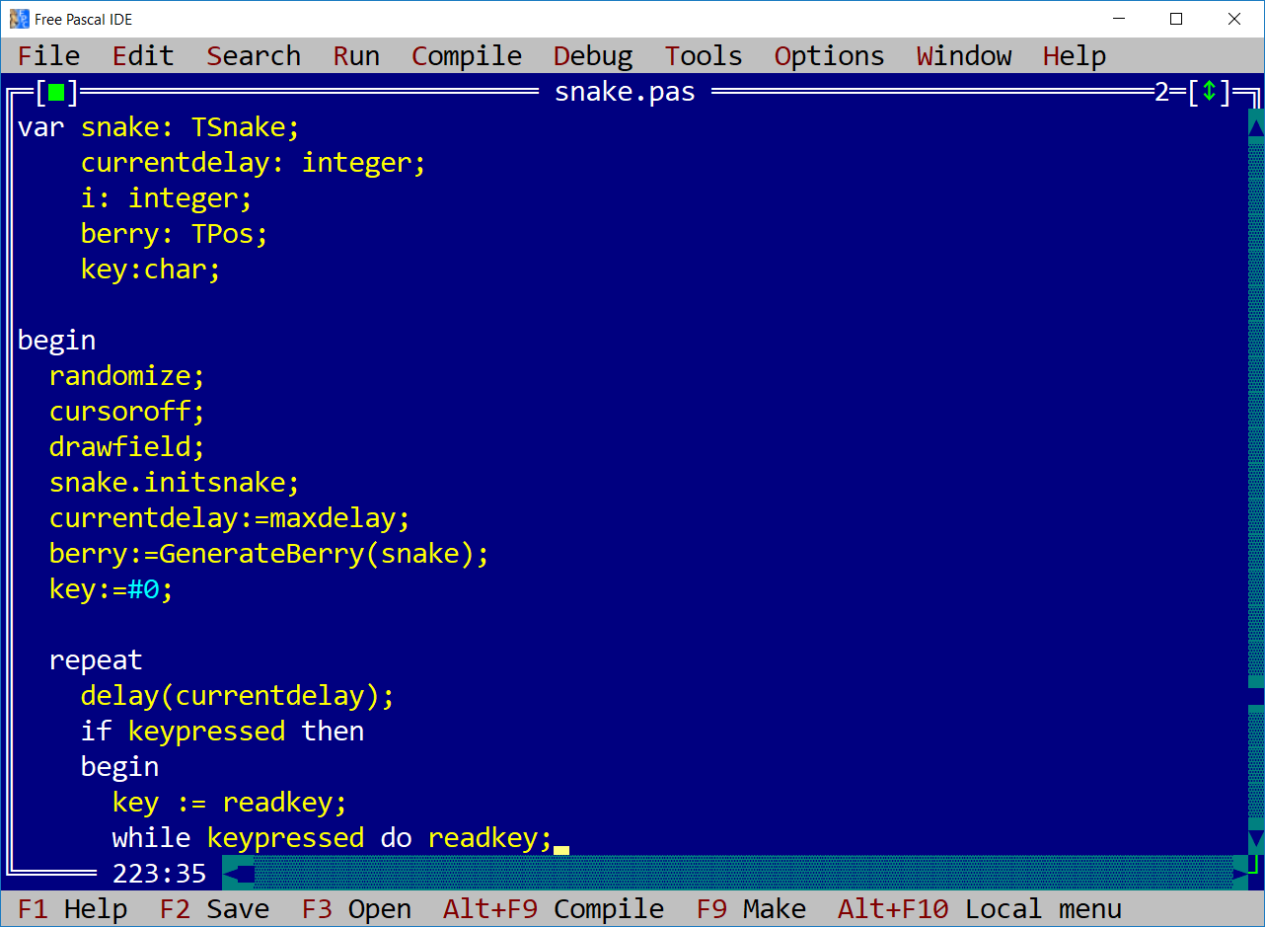
Syntax and Structure
Pascal's way of writing code is clear and easy to read.
Programs are split into sections, each with its own job.
Keywords like "begin" and "end" help keep code organized.

Slide 5
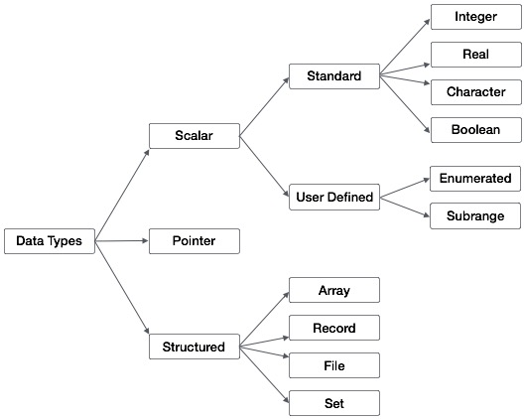
Data Types and Control Structures
Pascal can handle different types of data, like numbers and letters.
It can control how code runs using loops and conditional statements.
It offers ways to organize complex data effectively.

Slide 6
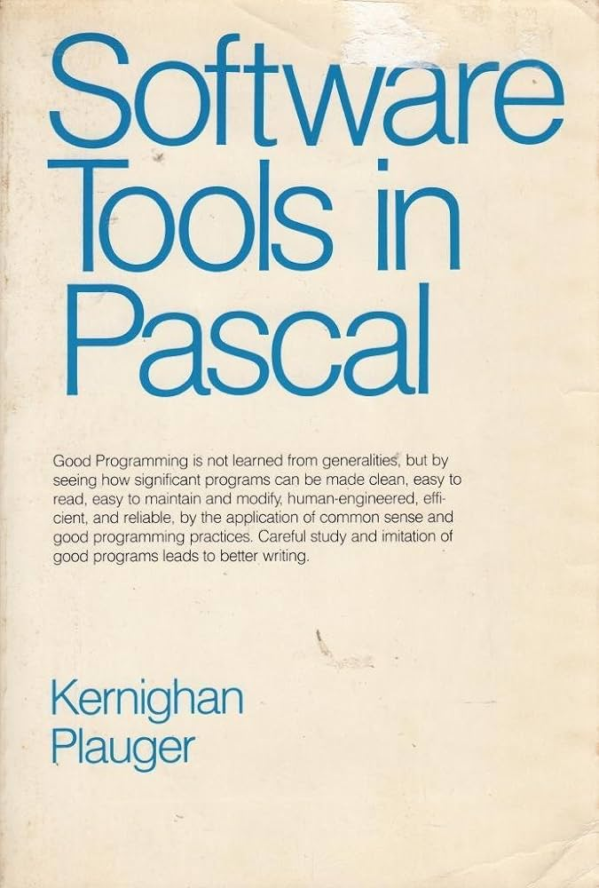
Standard Library and I/O
Pascal comes with tools for common tasks like math and working with text.
It's easy to read from and write to the screen or files.
Pascal's simple way of working with data is great for beginners.

Slide 7
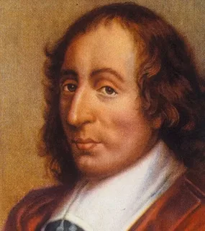
Applications and Legacy
Pascal has been used a lot in schools for teaching programming.
It's the basis for other languages like Modula-2 and Ada.
While it's not as common in businesses now, Pascal still influences how we learn programming.

Slide 8
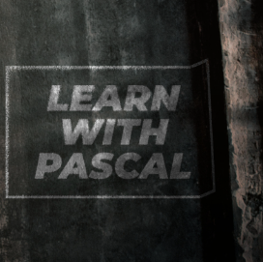
Conclusion
Pascal is a simple programming language that's great for learning.
Even though it's not used as much in business, it's still helpful for learning programming basics.

Slide 9
Thanks for listening!

